Slide 1

Negation and Uncertainty Detection using Classical and Machine Learning Techniques
Authors: Suzana Jeal, Piotr Bonara, Iker Romero Cespedes, Miriam Morales Franco, Adnan Boukfal Lazaar

Slide 2
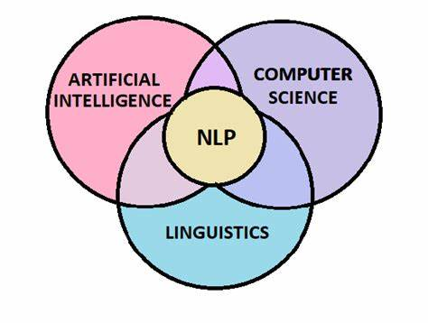
INTRODUCTION
Task: Detect negation and uncertainty in clinical narratives
Importance: Critical for clinical decision-making, coding, and research
Problem: Identify cue expressions and their scopes (text affected by the cue)
Labels: NEG, NSCO (negation cue and scope), UNC, USCO (uncertainty cue and scope)

Slide 3
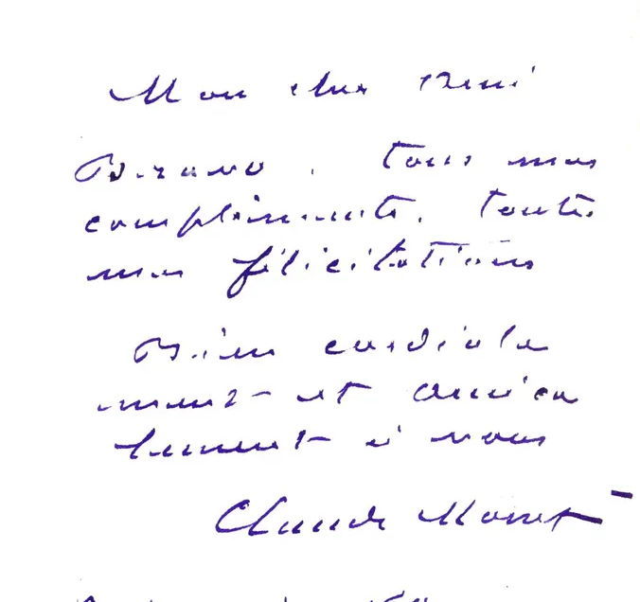
DATA EXPLORATION AND CHALLENGES
Clinical notes often mix unstructured Spanish and Catalan
Redacted patient data, telegraphic style, domain-specific terms
Difficulties: noisy formatting, ambiguous cues, variable scope lengths
Sample size: Documents with 2–10 cues on average

Slide 4
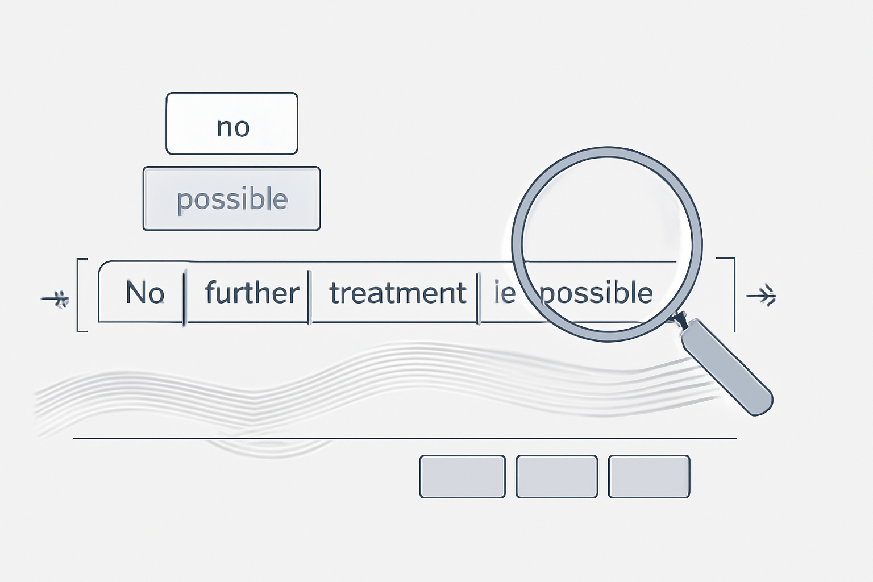
RULE-BASED APPROACH
Inspired by NegEx system
Uses curated lexicons for negation and uncertainty triggers
Detects cue and scope with fixed token window (±5 tokens)
Applies normalization and tokenization preprocessing

Slide 5
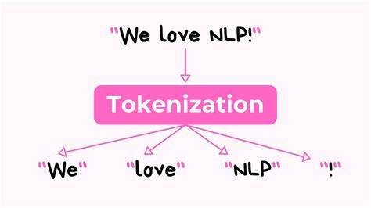
RULE-BASED IMPLEMENTATION
Trigger lexicons with multi-word expressions (e.g., "no hay evidencia de")
Preprocessing: lowercasing, accent removal, puntuaction stripping
Scope detection window of 5 tokens before and after cue
Character-level annotation for evaluation compatibility

Slide 6
RULE-BASED SYSTEM EVALUATION
Label | Precision | Recall | F1-Score
NEG | 0.94 | 0.92 | 0.93
NSCO | 0.92 | 0.95 | 0.93
UNC | 0.73 | 0.82 | 0.77
USCO | 0.75 | 0.84 | 0.79
High accuracy for negation cues and scopes
Moderate for uncertainty detection
Limitations: misses nuanced expressions, limited context

Slide 7
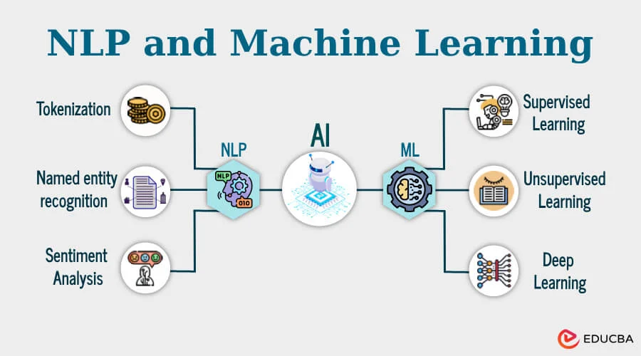
MACHINE LEARNING APPROACH
Supervisded learning model with BIO tagging scheme
Extracts lexical, contextual and positional features
Uses SGD Classifier (linear model with stochastic gradient descent)
Data Split: 80% training, 20% testing

Slide 8
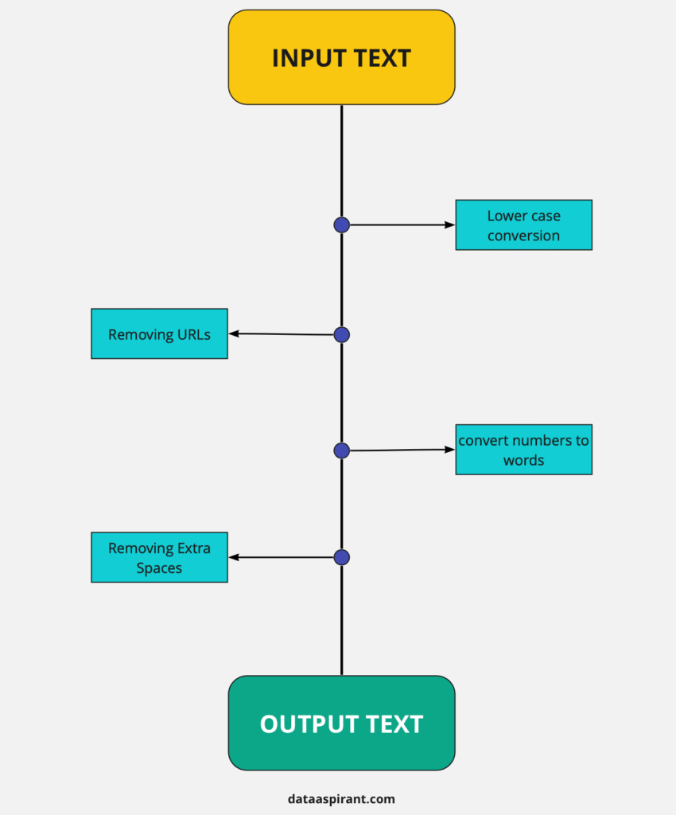
MACHINE LEARNING DETAILS
Preprocessing: White spaces tokenization, punctuation removal
BIO labels: B-(begin), I-(inside), O-(outside)
Features: token case, digit presence, neighbours, sentence boundaries
Vectorization with DictVectorization and LabelEncoder

Slide 9
MACHINE LEARNING EVALUATION
Label | Precision | Recall | F1-Score
B-NEG | 0.96 | 0.95 | 0.95
B-NSCO | 0.94 | 0.85 | 0.89
B-UNC | 0.90 | 0.41 | 0.57
B-USCO | 0.83 | 0.39 | 0.53
- Overall accuracy: 95%
- Good performance on negation cues
- Lower recall for uncertaincy and multi-token spans

Slide 10
CONCLUSIONS AND FUTURE WORK
Rule-based system: precise, interpretable baseline, limited coverage
Machine learning: strong negation detection, needs improvements on uncertainty
Future: sequence models (CRF, transformers) for better context handling
Potential: hybrid systems combining rules and ML for robustness

Slide 11
THANK YOU!
Questions?

